Slide 1
Responses apı
Gülşen sabak
2019

Slide 2
INTRODUCTION
BUILT- IN TOOLS
AGENTS SDK
Agent?
Previous agents
Web Search Tool
File Search Tool
Computer Use Tool
Code Practices
Responses API
Swarm
Agents SDK?
Handsoff
Debug
Code Practices

Slide 3
AGENT
A system that can act independently to do tasks on your behalf
They have launched 2 different agents this year:
Web Search Operator: browse the web and do things for us on the web
Deep Research: can create detailed reports for you on any topic you want

Slide 4
Buılt- ın tools

Slide 5
Web search tool
Allows models to reach the internet, access information from the internet.
Aim: the responses should be up to date and factual
How it Works: Look the large amount of data coming from the web and finding the relevant pieces of information and citing it in its response.
Works fine with fine tuned 4o, or 4o mini
Good for public data
Benchmark: SimpleQA Accuracy

Slide 6
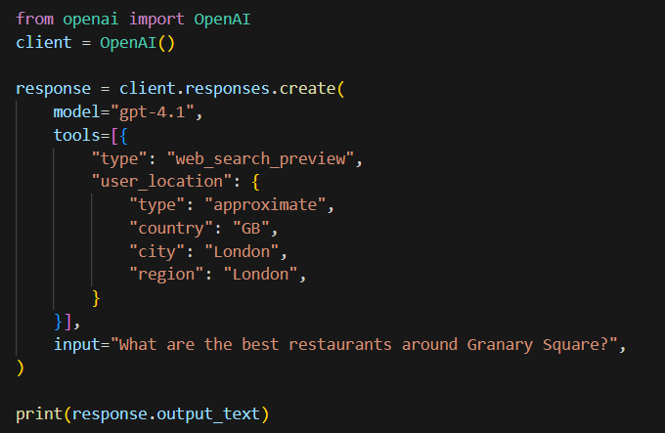
Web search tool Code Practices

Slide 7
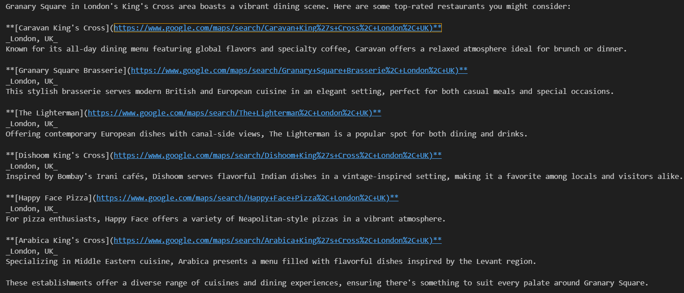
Web search tool Code Results

Slide 8
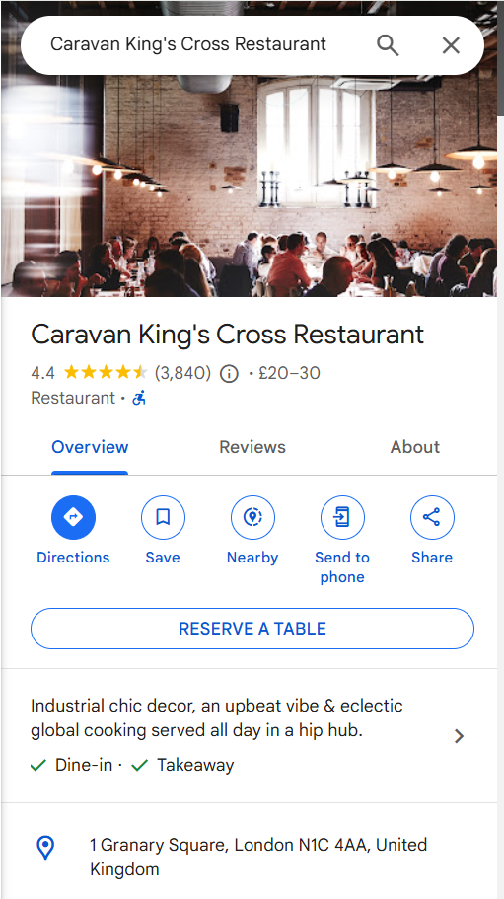
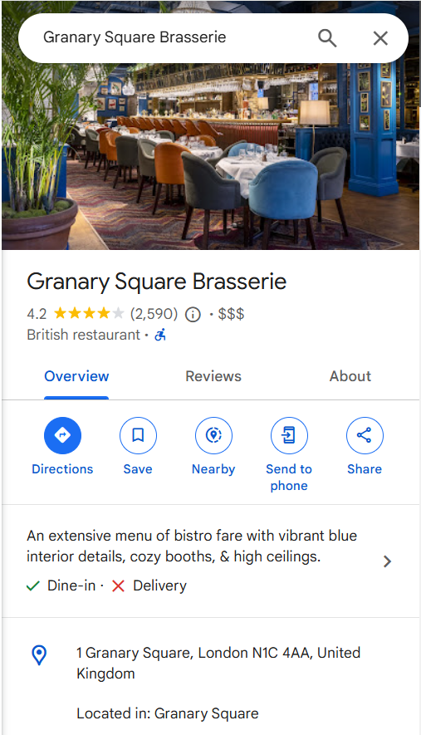
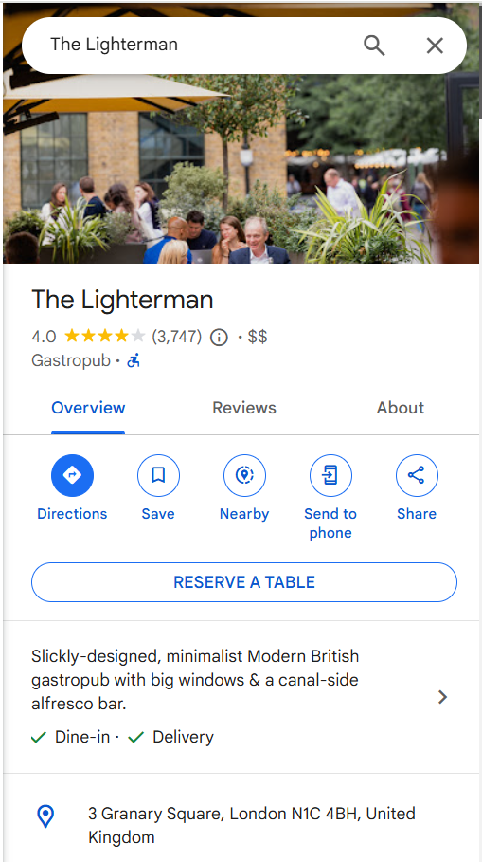
Web search tool Code Results

Slide 9
File search tool
It is for developers to upload, chunk, embed their documents and then do rag easily over those documents.
Launched in the assistance api
Good for private data
2 new features:
Metadata filtering: with metadata filtering, you can add attributes to files to be able to easily filter them down to just ones that are the most relevant for your query.
Direct Search endpoint: you can directly search your vector stores without your queries being filtered through the model.

Slide 10
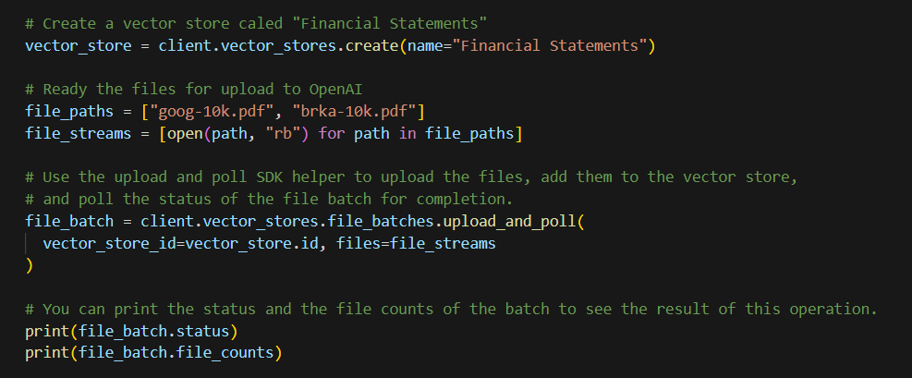
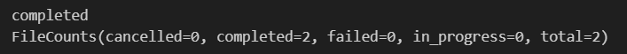
File search tool Code Practices

Slide 11
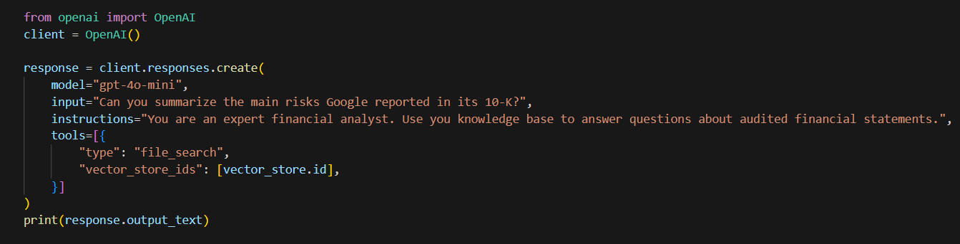
File search tool Code Practices

Slide 12
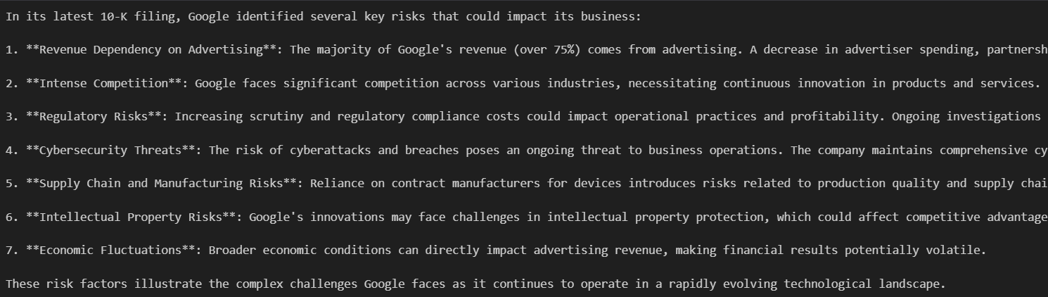
File search tool Code Results

Slide 13
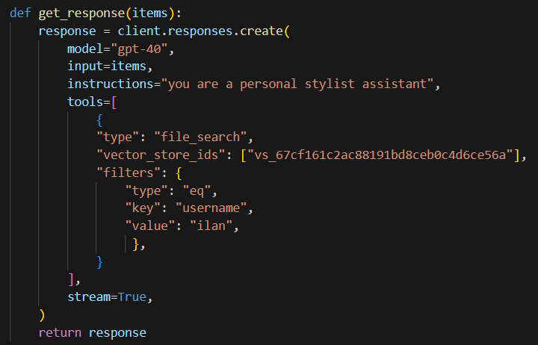
File search tool metadata filtering

Slide 14
Computer Use tool
It allows you to control the computers that you are operating. It could be a virtual machine, legacy application (just has GUI and no API access to it).
Operator in the API
If you want to automate those kind of tasks and build applications on that you can use the computer use tool which comes with the computer use model (same model used by operator in chat gpt)
Benchmark: Sota

Slide 15
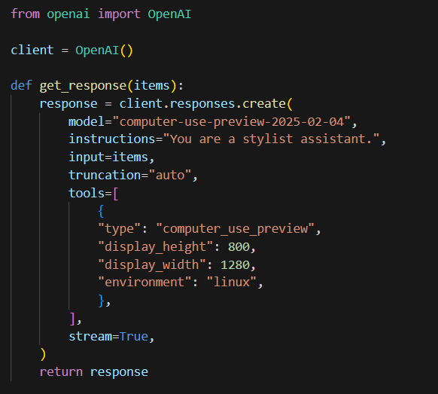
Computer use tool Code Practices

Slide 16
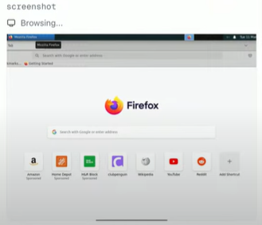
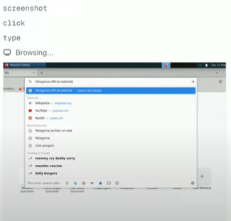
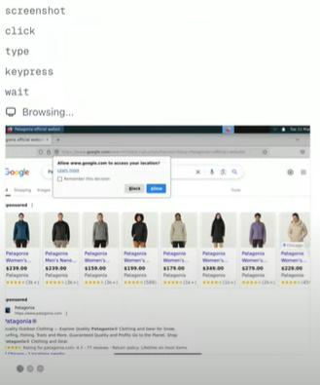
Computer use tool Code Practices

Slide 17
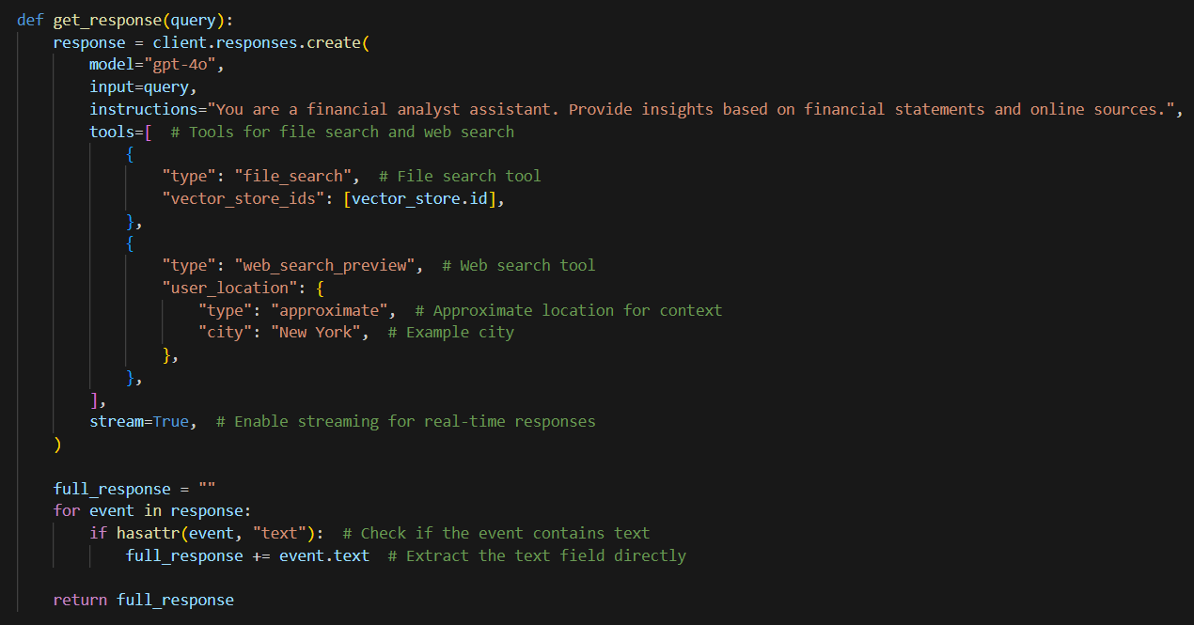
Use tools together

Slide 18
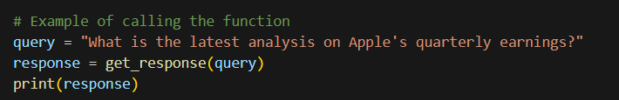
Use tools together

Slide 19
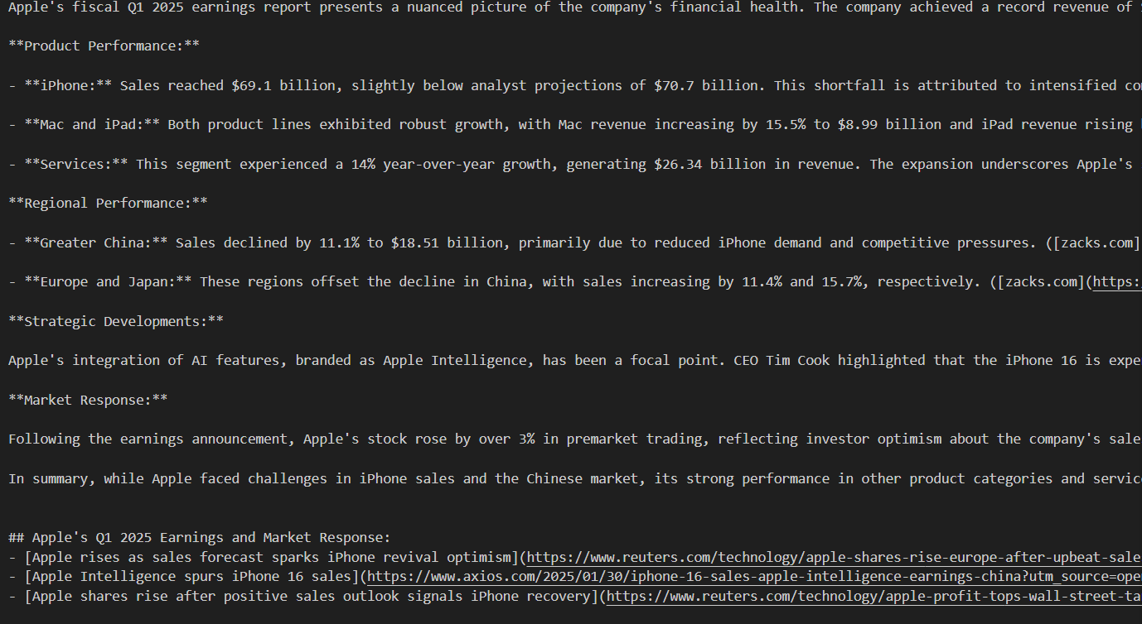
Use tools together

Slide 20
Agents sdk

Slide 21
Responses API
Chat completions is also a kind of API interaction
Every API interaction at that time was just text in text out.
However now we have multimodality so you have images, audio etc.
Multiple model turns and multiple tool calls behind the scenes.
If you want to build an API primitive that is flexible enough. It supports multiple terms, tools.
We call this new API as the “responses API”

Slide 22
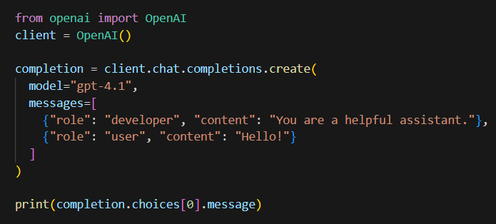
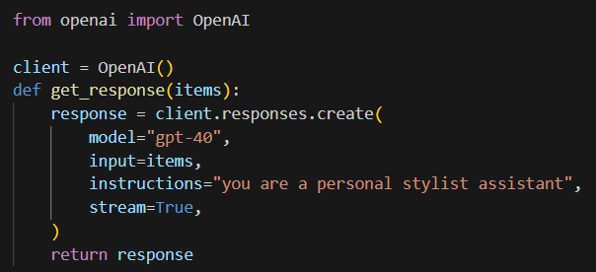
Chat Completions vs Responses API
Previous Now

Slide 23
Swarm
You may have more complex systems. For example, in customer support systems you have some agentic applications that are doing your refunds, another that is answering customer support, faq queries, something dealing with orders and billing etc.
To make these applications easy to build they released an SDK called “swarm”
Swarm made it easy to do agent orchestration. Adding new features and rebranding it as “agents SDK”

Slide 24
Agents SDK
Idea with the agents SDK is “keep simple ideas simple to implement while allowing you to build more complex and robust ideas still in a pretty straightforward and simple way.”
When you add more tools to your system, when you start to mix all of this business logic which makes your agents a little bit harder to test and so this is the power of multiple agents is you can actually, separate your concerns and develop and test them separately.

Slide 25
Agents SDK
One of the best properties of the agents SDK:
Take python functions and look at the type inference or look at the type signatures and then automatically generate the JSON schema that the models need to use to perform those function calls. Once they do, we actually run the code and then return the results.
How do we interact with both of them as a user?

Slide 26
Handsoff
Simple but powerful idea.
When you have one conversation where one agent is handling it and then it hands it off to another where you keep the entire conversation the same but behind the scenes you just swap out the instructions and the tools.
This gives us a way to triage conversations and like loads in the correct context for each part of the conversation. You can create a triage agent that can hand off to the stylist agent or the customer support agent. (It starts with this triage agent.)

Slide 27
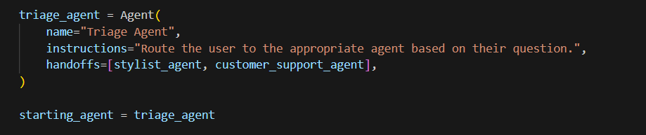
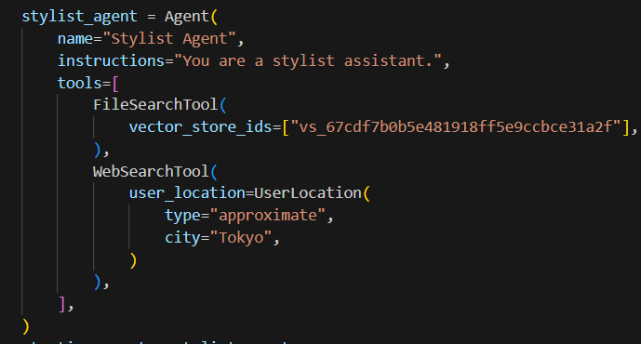
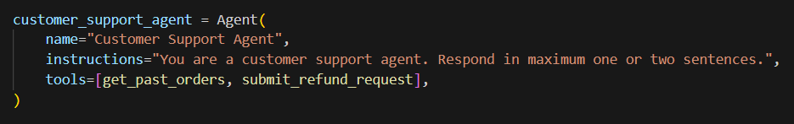
Handsoff

Slide 28
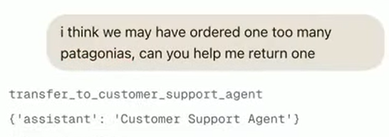
Handsoff

Slide 29
Debug
Agents SDK brings out of the box monitoring and tracing.
There exists a Tracing UI in their platform.
Handoffs are first class objects in that dashboard.
You can see not only which agent we actually handed it off to but any that it like it had has options that it did not. (really useful feature for debugging)

Slide 30
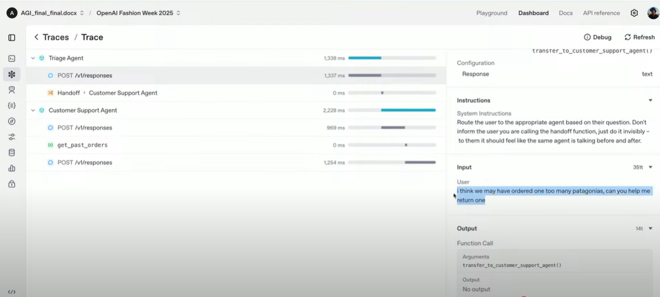
Debug

Slide 31

Thanks For Listening
Gülşen Sabak

